Slide 1
Harold Pulcher
Senior Consultant and Microsoft MVP

Slide 2
Upcoming Virtual Training Courses
Professional Scrum with Kanban (PSK) Certification Course January 26-27
where participants learn how to leverage Scrum to maximize the value of products and services The Professional Scrum Product Owner (PSPO) is a 2-day certification training (offered online and in person) .
Professional Scrum Master (PSM) Certification Course February 09-10
Professional Scrum Master (PSM) is a 2-day certification course (offered online and in person) that explains the principles and empirical process theory behind the Scrum framework, and the important role that the Scrum Master has in it.
Professional Agile Leadership - Essentials (PAL-E) Certification Course February 16-17
The Professional Agile Leadership Essentials (PAL-E) course provides a foundation for the role that leaders play in creating the conditions for a successful Agile transformation. This course was developed by Scrum.org in collaboration with the Professional Scrum Trainer community. After the class, students are eligible for the PAL I assessment certification. If you pass the assessment, you will gain the industry recognized PAL I certification. This certification will NEVER expire, and it makes you part of an elite community of PAL I badge holders.
For more information or to sign-up, visit:
www.improving.com/training

Slide 3

Open Positions
1
Technical Product Owner Location: Plano, TX
5
Guidewire Developer Location: Columbus OH
Product Manager Location: DFW
Senior Java Software Engineer with AWS, and Docker exp. Location: DFW
2
6
3
Corporate Technical Recruiter Location: Frisco TX
7
Automation Tester with .NET experience Location: DFW
4
Azure Infrastructure Architect Location: DFW
Location: DFW
8
Web Developer Location: Frisco, TX
Resumes to careers@improving.com
Improving.com/careers

Slide 4
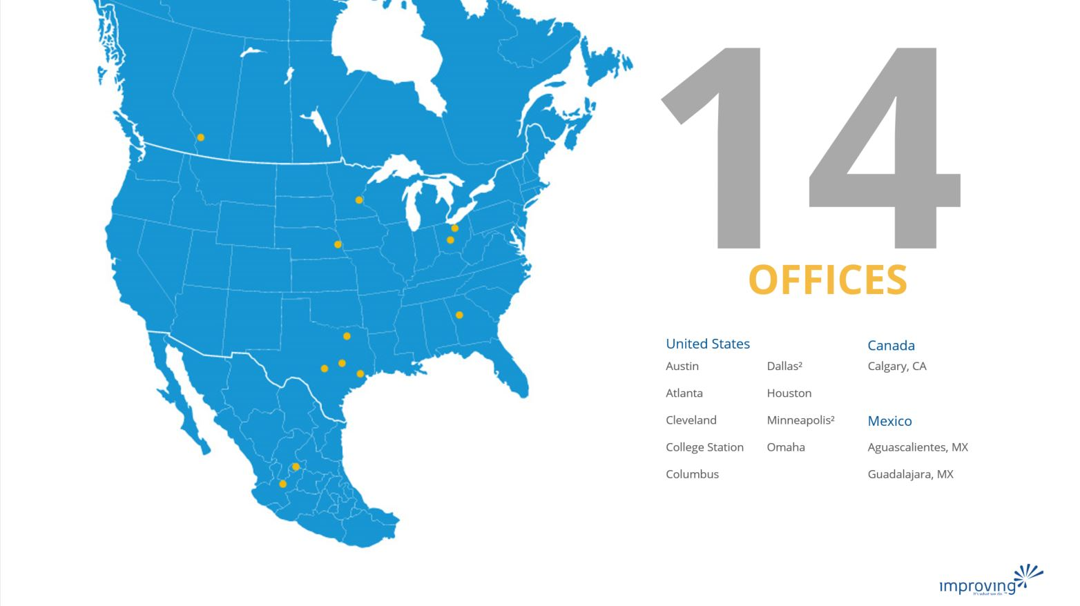
Share details about an upcoming event, conference, user group, booth raffel ect here.

Slide 5
Training class advertisement here​
For details around upcoming training courses available, please check with your local business development managers/office leadership
Fridays at 12pm CST
See past talks on our YouTube Page
https://bit.ly/2Rd0WC5

Slide 6
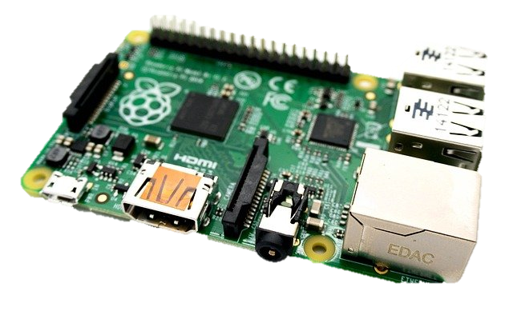
.NET 5 with a slice of Pi
Harold Pulcher (MVP) @haroldpulcher harold.pulcher@improving.com
https://youtube.com/user/hpulcher https://twitch.tv/haroldpulcher
http://bit.ly/dotnet-pi
Notes:
Put on title….
Linux logo?
RPI?
LED?
Pushbutton?
My headshot
Update github link
Add Discord link

Slide 7
Agenda:
Overview
Requirements
Set It Up
Hello World!
Let’s make it better
Talking Head
My ask and questions

Slide 8

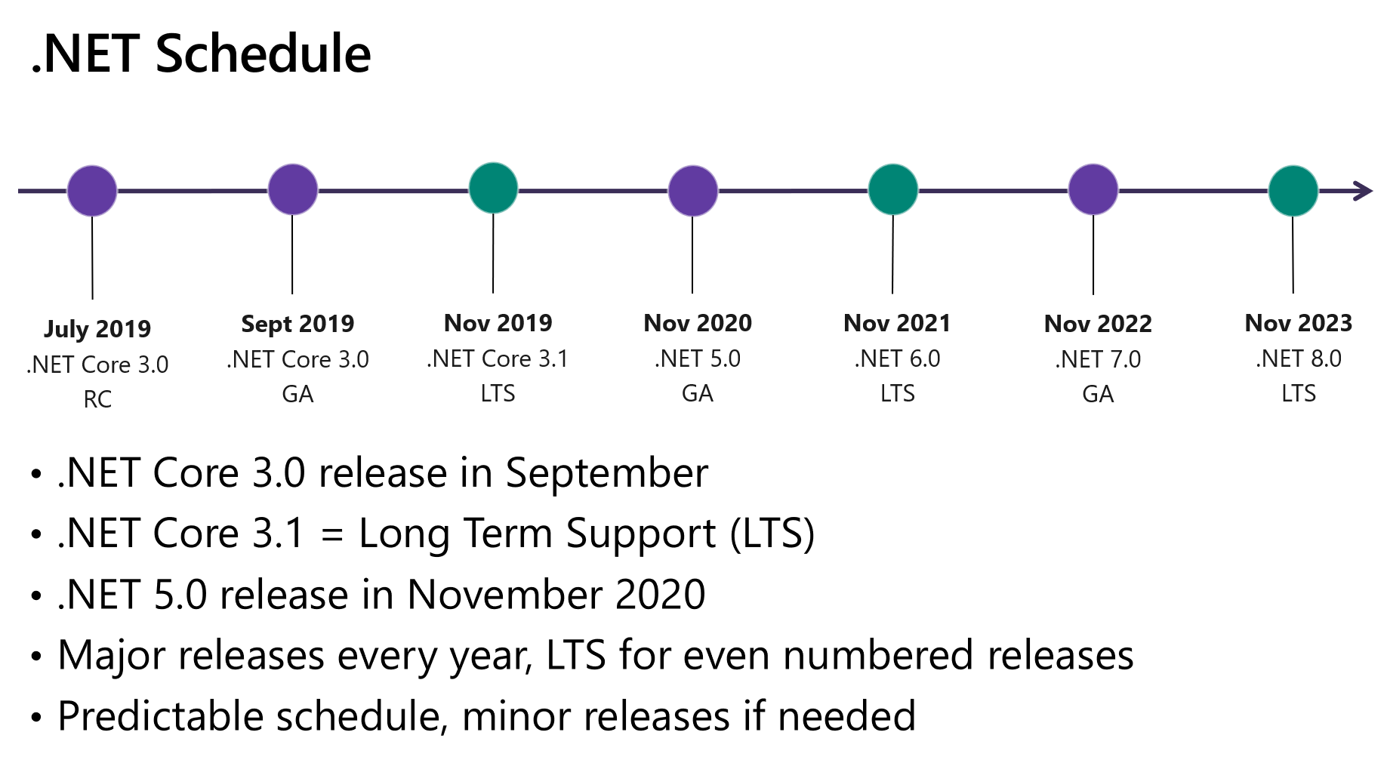
Overview
Notes:
Timeline
Supported platforms
Where to get it
Show page and talk about he various bundles
Get some .NET 5 logo and a Microsoft logo….

Slide 9
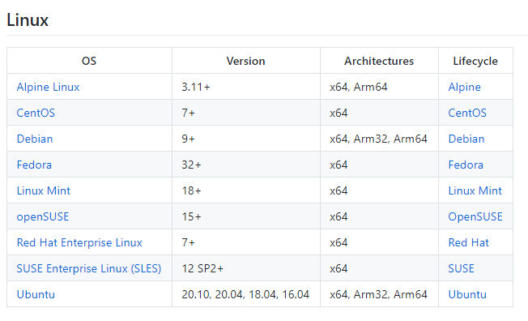
So what distro can I use?
https://docs.microsoft.com/en-us/dotnet/core/install/linux
Notes:
Timeline
Supported platforms
Where to get it
Show page and talk about he various bundles
Get some .NET 5 logo and a Microsoft logo….

Slide 10
Requirements….
Have to have:
Nice to have:
Supported OS
Ubuntu 20.04 in this presentation
.NET 5 SDK for your OS
Microsoft’s dependency package installed
Raspberry Pi 4
Pi 3’s will work. Sorry Pi 2’s there is a current bug
Your favorite Linux editor
I like vi. Anyone still use emac’s?
A network connection
Guessing I shouldn’t have to say this.
Access to ‘root’ on the Linux OS
Visual Studio Code
Visual Studio Community
There are a few extensions
Remote Development Extension Pack
Access to an SSH client
OpenSSH is now on Windows 10
WSL2
Windows Terminal
.NET 5 SDK for your OS
Windows 10
Notes:
VS Code, VS community
Ssh Client (openssh now included on windows 10)
Installed Linux – VM, WSL2, Raspberry Pi, etc….
My current setup

Slide 11
Setup
Install the Microsoft dependencies:
wget https://packages.microsoft.com/config/ubuntu/20.04/packages-microsoft-prod.deb -O packages-microsoft-prod.deb
sudo dpkg -i packages-microsoft-prod.deb
Notes:
Prepare the Windows side
Windows Terminal Server
OpenSSH built in
ssh-keygen
Prepare the Linux side
Learn a little Linux
- vim, nano, pico, etc…
- sudo
- ls, etc…
Ensure that ssh is enabled
- /etc/ssh/sshd_config
- - allow root login
copy pub from windows and append to .ssh/authorized_keys
decide user level or global
-- /usr/share/dotnet vs ~/dotnet
download the bundle and expand to the correct place
Add to PATH and env vars: .bashrc
Install the devian ms package
Attempt to login from windows to linux without needing the password…..
Make another identity file for root@. Copy that .pub into the ~root/.ssh/authorized_keys
Make sure you can login without a password being asked for.
Yeah, I know….. This makes me nervous too……

Slide 12
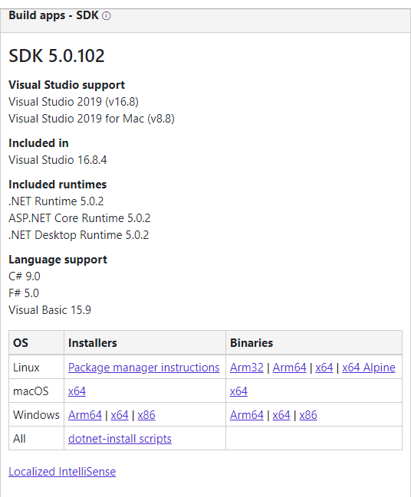
Setup
Download the .NET package:
https://dotnet.microsoft.com/download/dotnet/5.0
Notes:
Prepare the Windows side
Windows Terminal Server
OpenSSH built in
ssh-keygen
Prepare the Linux side
Learn a little Linux
- vim, nano, pico, etc…
- sudo
- ls, etc…
Ensure that ssh is enabled
- /etc/ssh/sshd_config
- - allow root login
copy pub from windows and append to .ssh/authorized_keys
decide user level or global
-- /usr/share/dotnet vs ~/dotnet
download the bundle and expand to the correct place
Add to PATH and env vars: .bashrc
Install the devian ms package
Attempt to login from windows to linux without needing the password…..
Make another identity file for root@. Copy that .pub into the ~root/.ssh/authorized_keys
Make sure you can login without a password being asked for.
Yeah, I know….. This makes me nervous too……

Slide 13
Setup
Unpack the tarball:
mkdir -p "$HOME/dotnet" && tar zxf dotnet-sdk-5.0.102-linux-x64.tar.gz -C "$HOME/dotnet"
Set your environment:
export DOTNET_ROOT=$HOME/dotnet
export PATH=$PATH:$HOME/dotnet
* For system installs use: /usr/share/dotnet in place “$HOME/dotnet”
Notes:
Prepare the Windows side
Windows Terminal Server
OpenSSH built in
ssh-keygen
Prepare the Linux side
Learn a little Linux
- vim, nano, pico, etc…
- sudo
- ls, etc…
Ensure that ssh is enabled
- /etc/ssh/sshd_config
- - allow root login
copy pub from windows and append to .ssh/authorized_keys
decide user level or global
-- /usr/share/dotnet vs ~/dotnet
download the bundle and expand to the correct place
Add to PATH and env vars: .bashrc
Install the devian ms package
Attempt to login from windows to linux without needing the password…..
Make another identity file for root@. Copy that .pub into the ~root/.ssh/authorized_keys
Make sure you can login without a password being asked for.
Yeah, I know….. This makes me nervous too……

Slide 14
Hello World?
Could it be this easy?
Notes:
Demo
Dotnet –list-sdks
Cd examples
Dotnet new console –n hello-improving
Dontnet runn
Show the directory structure…..

Slide 15
Let’s make betta’
Install Visual Studio Code
https://code.visualstudio.com/Download
Install Remote Development Extension
https://marketplace.visualstudio.com/items?itemName=ms-vscode-remote.remote-ssh
C# extension
https://marketplace.visualstudio.com/items?itemName=ms-dotnettools.csharp
Notes:
Prepare the Windows side
Windows Terminal Server
OpenSSH built in
ssh-keygen
Prepare the Linux side
Learn a little Linux
- vim, nano, pico, etc…
- sudo
- ls, etc…
Ensure that ssh is enabled
- /etc/ssh/sshd_config
- - allow root login
copy pub from windows and append to .ssh/authorized_keys
decide user level or global
-- /usr/share/dotnet vs ~/dotnet
download the bundle and expand to the correct place
Add to PATH and env vars: .bashrc
Install the devian ms package
Attempt to login from windows to linux without needing the password…..
Make another identity file for root@. Copy that .pub into the ~root/.ssh/authorized_keys
Make sure you can login without a password being asked for.
Yeah, I know….. This makes me nervous too……

Slide 16
Let’s make betta’
Generate 2 ssh authorization keys on Window
ssh-keygen –t rsa –b 4096
ssh-keygen –t rsa –b 4096 –f id_rsa_root
Copy the *.pub files to the Pi
scp .ssh/*.pub ubuntu@192.168.1.x:
Doesn’t really matter how your get them there, just get them there.
Ensure ssh access is enabled on the remote Pi
https://linuxize.com/post/how-to-enable-ssh-on-ubuntu-20-04/
Don’t really know these guys, but the setup they show is pretty easy to follow
Notes:
So where do these files get created?
Prepare the Windows side
Windows Terminal Server
OpenSSH built in
ssh-keygen
Prepare the Linux side
Learn a little Linux
- vim, nano, pico, etc…
- sudo
- ls, etc…
Ensure that ssh is enabled
- /etc/ssh/sshd_config
- - allow root login
copy pub from windows and append to .ssh/authorized_keys
decide user level or global
-- /usr/share/dotnet vs ~/dotnet
download the bundle and expand to the correct place
Add to PATH and env vars: .bashrc
Install the devian ms package
Attempt to login from windows to linux without needing the password…..
Make another identity file for root@. Copy that .pub into the ~root/.ssh/authorized_keys
Make sure you can login without a password being asked for.
Yeah, I know….. This makes me nervous too……

Slide 17
Let’s make betta’
Give root a logon password
sudo passwd root
Put the pub files in the correct place
cat id_rsa.pub >> .ssh/authorized_keys
sudo cat id_ras_root.pub >> /root/.ssh/authorized_keys
Be sure to dump the .pub files when you are done. They are no longer needed.
Tell the SSH daemon that root can login
sudo vi /etc/ssh/sshd_config
Uncomment and change the following line to:
PermitRootLogin yes
Save the file and reboot
Notes:
So where do these files get created?
Prepare the Windows side
Windows Terminal Server
OpenSSH built in
ssh-keygen
Prepare the Linux side
Learn a little Linux
- vim, nano, pico, etc…
- sudo
- ls, etc…
Ensure that ssh is enabled
- /etc/ssh/sshd_config
- - allow root login
copy pub from windows and append to .ssh/authorized_keys
decide user level or global
-- /usr/share/dotnet vs ~/dotnet
download the bundle and expand to the correct place
Add to PATH and env vars: .bashrc
Install the devian ms package
Attempt to login from windows to linux without needing the password…..
Make another identity file for root@. Copy that .pub into the ~root/.ssh/authorized_keys
Make sure you can login without a password being asked for.
Yeah, I know….. This makes me nervous too……

Slide 18
Now what command-line boy?
Install the remote debugger on the Pi
curl -sSL https://aka.ms/getvsdbgsh | /bin/sh /dev/stdin -v latest -l ~/vsdbg
Notes:
So where do these files get created?
Prepare the Windows side
Windows Terminal Server
OpenSSH built in
ssh-keygen
Prepare the Linux side
Learn a little Linux
- vim, nano, pico, etc…
- sudo
- ls, etc…
Ensure that ssh is enabled
- /etc/ssh/sshd_config
- - allow root login
copy pub from windows and append to .ssh/authorized_keys
decide user level or global
-- /usr/share/dotnet vs ~/dotnet
download the bundle and expand to the correct place
Add to PATH and env vars: .bashrc
Install the devian ms package
Attempt to login from windows to linux without needing the password…..
Make another identity file for root@. Copy that .pub into the ~root/.ssh/authorized_keys
Make sure you can login without a password being asked for.
Yeah, I know….. This makes me nervous too……

Slide 19
Can we just see the debug demo now?
Still need to setup a launch and task file, but that is in the demo.
Notes:
Dotnet new console –n hello_world
Build it. Run it. local
Demo run it remote, no code change
Go through the pushblick code
Fire it up on the pi
Attach to it.
Set a break point.

Slide 20
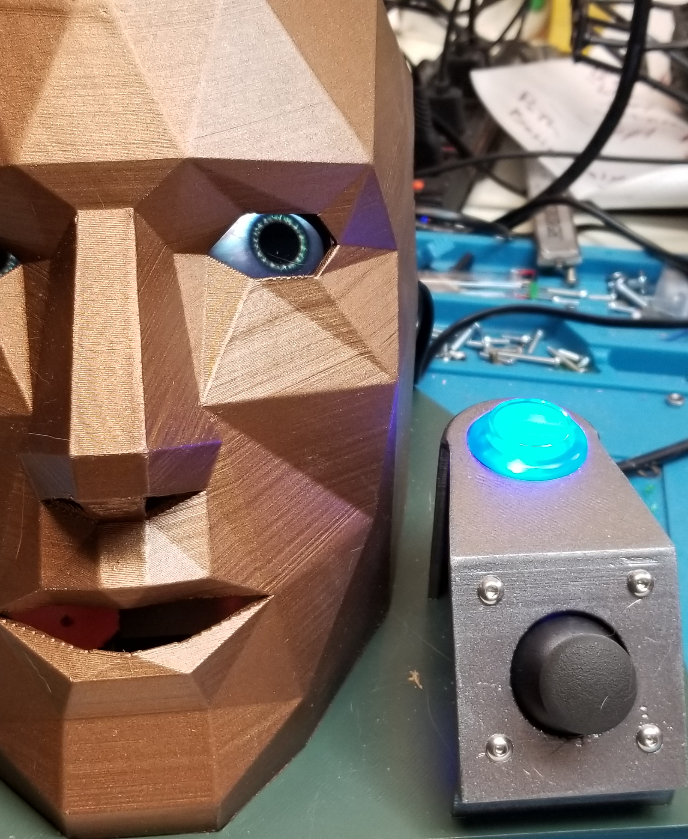
C# worker project….
Talking Head…
OS: Raspbian
Process starts at boot time
Controlled by the system
Integrates with all the standard logging
Button triggers a pick of some text and feeds that to an external program
Python is doing the eyes, https://www.adafruit.com/product/3813
Mask from thingiverse, all other parts modeled and printed
https://github.com/pulcher/TalkingHead
Notes:
Quick review of the project
Show the code and repo
Show how to start: dotnet new worker –n creepy-head
Push the button.

Slide 21
My Asks and question time:
Install .NET 5 and write a program or two
Get a Raspberry PI and some parts
Make something fun with both hardware and software
Follow me on Twitch and Twitter: @haroldpulcher
Send me some feedback: harold.pulcher@improving.com
Or better yet, create an issue and make a PR on the repo

Slide 22
Links and stuff
Talk github repo: http://bit.ly/dotnet-pi
Where to download .NET 5: https://dotnet.microsoft.com/download/dotnet/5.0
Manual install steps: https://docs.microsoft.com/en-us/dotnet/core/install/linux-ubuntu#2004-
Scott Hanselman helped: https://www.hanselman.com/blog/remote-debugging-with-vs-code-on-windows-to-a-raspberry-pi-using-net-core-on-arm
Adafruit eyes: https://www.adafruit.com/product/3813
Talking Head: https://github.com/pulcher/TalkingHead
* All images are personal or obtained from the “free” section of pixabay.com

